Slide 1
Predicting NF2 with neural crest data
Ankita Das, Don Andres, Akshay Maheshwari, Chaintanya Kulkarni, Calvin Legassick, Paul Kim

Slide 2
What are the regulatory and gene expression changes that occur in NF2 disease? Can we leverage these to find new drug targets?

Slide 3
What are the regulatory and gene expression changes that occur in NF2 disease? Can we leverage these to find new drug targets?
Almost no NF2 patient data publically available :-(

Slide 4
Our solution: Leverage related data
Compare transcriptomic data from:
Embryonic normal neural crest cells
Neural crest tumors/cancers
Other NF2 gene mutation tumors/cancers
Identify relationships in gene expression between the three classes
Predict outcomes & determine NF2 causing gene pathways/networks

Slide 5
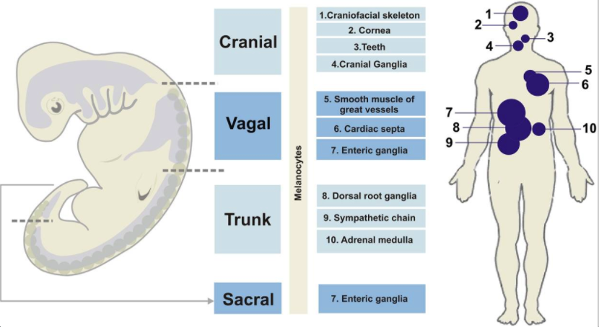
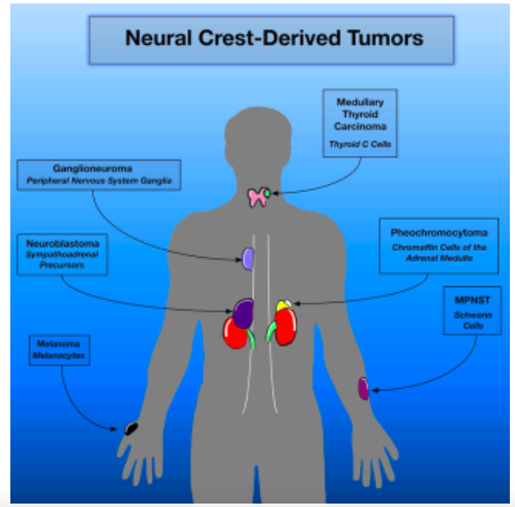
Neural crest: Cellular origin of NF2
Developing embryo
Normal adult neural
Crest tissues
Neural crest tumor

Slide 6
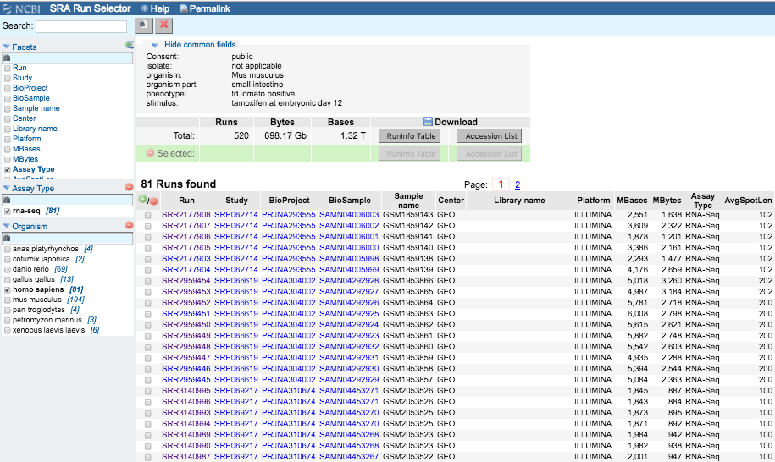

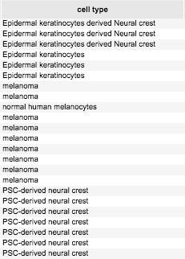
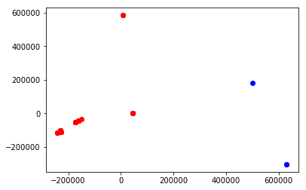
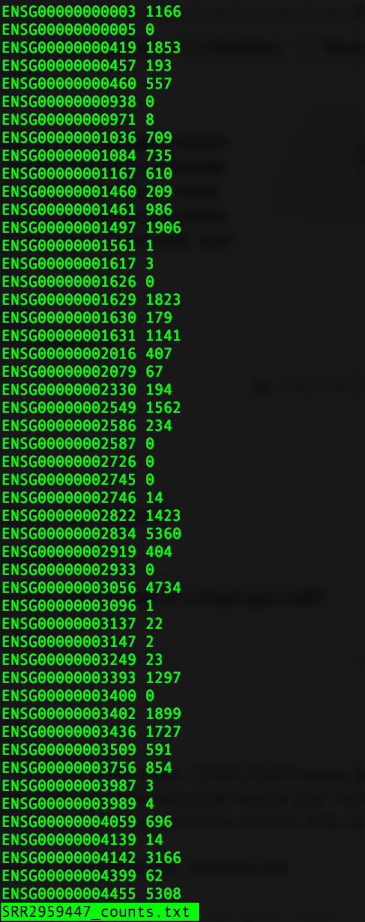
How it works
Identify genes whose expression differences most accounts for separation between classes ( normal vs tumor )
RNA-seq data from NCBI
Bioinformatics
Gene ontology of the top genes
To determine NF2 related pathways
ML algorithms to reduce dimensionality

Slide 9
What is the problem/ unmet need that we are solving?
What are the regulatory network and gene expression changes that occur in NF2 disease? Can we leverage these to find new drug targets?
Mutation in the NF2 gene does not always cause NF2
Why is that ? and what else is/ are the contributing factors ?

Slide 10
Neural crest: Cellular origin of NF2
Developing embryo
Normal adult neural
Crest tissues
neural crest tumor

Slide 11
What is the solution/ hypothesis to get to the solution
Comparison of transcriptomic data across different samples :
Embryonic normal neural crest,
Neural crest tumors/cancers
Other NF2 gene mutation tumors/cancers
Find commonalities and differences in expressed genes
Predict outcome & determine NF2 causing gene pathways/ networks

Slide 12
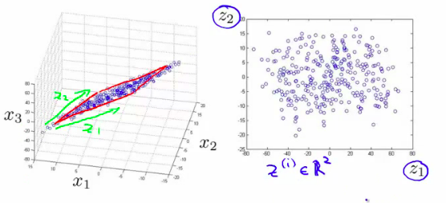
How it works
Identify genes whose expression differences account for separation between classes ( normal vs tumor )
RNA-seq data from NCBI
Bioinformatics
Gene ontology of the top genes
To determine NF2 related pathways
ML algorithm to define dimensions

